Slide 2
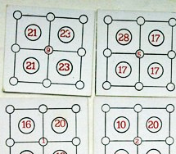
2.3 Combination 9
Objectives
The game was chosen, because of its brain drilling capabilities. It adheres to levels three “Applying” and six “Evaluating” of “Taxonomy of Educational Objectives”
Participants should be taught to sum four single digit numbers fast and reliably.
They understand that if numbers are rearranged the sum is different.
They try to rearrange numbers until preliminary given result is reached
They should understand that the game has optimal strategy and try to achieve it intuitively or mathematically proven
Tools, Materials and Organisation
Game cards.
Prepare copies from the worksheet for each student.
The lesson takes 45 minutes.

Slide 3
2.3 Combination 9
Description of the Lesson
First part of the lesson (20 minutes)
Make groups of 2 to 4 participants.
The participants play several times the game “Combination 9” to learn the rules and objectives. On first tries no time limitation is defined.
The participants learn to sum and rearrange numbers until the solution is found.
Players rise hand when they find a solution.
The others students can check their answer. After that teacher checks the correctness of the answer
When the participants become more experienced, competition is announced. When participant finds a solution, the time is recorded. Wins the fastest competitor.
The game could be played in rounds of several games each.
The competition may be for individuals or played by teams.
Introduce the idea that the game has optimal strategy to find a solution. Remember that there are 362880 card variants including symmetric.

Slide 4
2.3 Combination 9
Second part of the lesson
Hand out the worksheets to each person one.
Follow the instruction on the worksheet.
Useful Hints
At the end of the lesson the worksheet is completed.
If the participants cannot read, the teacher has to guide them..
If the participants can’t understand the rules, the teacher has to guide them.
If participants have difficulties to sum and combine numbers, you have to divide the lesson into two lessons: First lesson: sum numbers, second lesson: rearrange numbers.

Slide 5
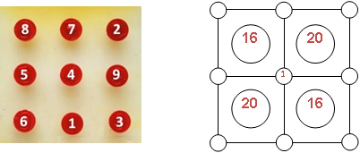
2.3 Combination 9
The game set includes - two square boards with nine nests placed on them, nine green and nine red pawns numbered from 1 to 9 and 35 cardboard squares with height and width 10.4 cm (carnets). Upon them a scheme of 9 circles placed on the edges of 4 similar squares is drawn. Within the circle situated in the centre of the carnet a random digit from 1 to 9 is placed (so-called condition-number), and within the squares a random two-digit number up to 30 is placed (so-called task-number). The circles correspond to the nests on the game boards. After all the carnets are shuffled, the players take a carnet and place it on one of the game boards aiming to arrange the number in the central circle (condition-number), to place the numbers in the rest of the circles on the edges of the squares, but considering the sum of the digits around each square to be equal to the digit inside of it (task number).
Task: Place the numbered pawns to the one selected carnet – the sum of the four numbers must be equal to the number in the big circle! Try as long as all numbers are put to the carnet.

Slide 6
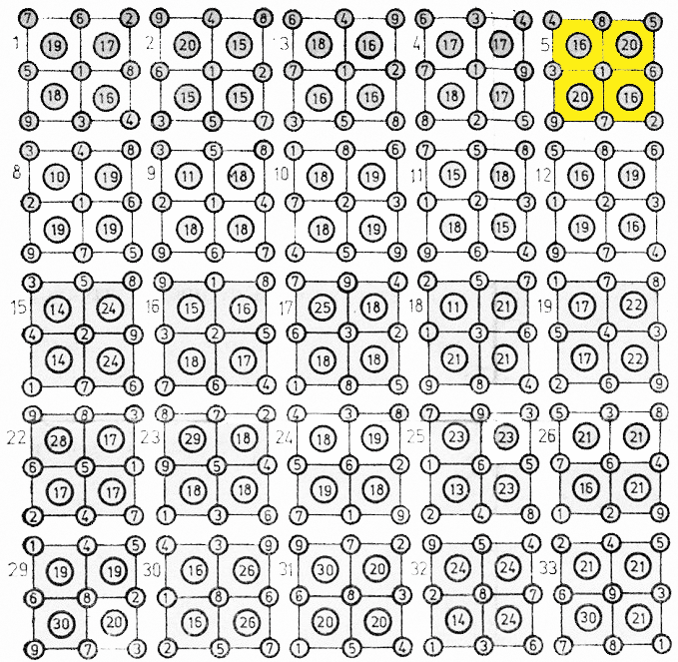
2.3 Combination 9
Solution of some examples of carnets

Slide 7
2.3 Combination 9
The game proceeds in two phases:
Random choice of carnet
Solution of the carnet
16
20
1
1st Phase: Random choice of carnet
One of the players shuffles the carnets and the participants in the game take them without looking. Each player places the carnet that he took on the game board.
2nd Phase: Solution of the carnet
The game begins when all the players place their numbered pawns in such combination that their sum equals the number in the centre of each of the four squares. The winner is the player who first fills correctly his carnet.
20
16
4
8
5
16
20
3
1
6
20
16
9
7
2

Slide 8
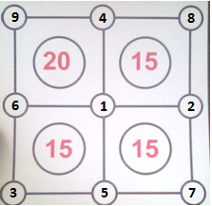
2.3 Combination 9
Players must be able to quickly collect numbers from 1 to 9 in order to place them in the right places.
The teacher has to check if they have done well.
Whoever has succeeded in arranging them for the shortest time is the winner.

Slide 9
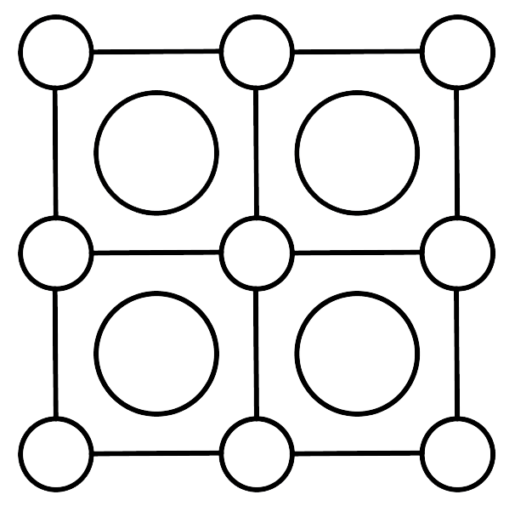
How to make a „nest“
10
15
15
15

Slide 10
How to solve a „nest“
14
14
23
18

Slide 11
Solution of the „nest“
14
14
23
18

